Slide 1
UGBA 141 Production and Operations Management
Strategy II Product Management
Professor Park Sinchaisri

Slide 2
Final Information 5/11 3-6pm
32 Q’s (35 pts): mix of quantitative and qualitative, integrative topics
SCM bullwhip effect, quick response (Obermeyer), contracts
Queue Little’s law, waiting time, throughput losses, pooling, psychology
Strategy revenue management, product management (IDEO)
Emerging transparency (Tessei), knowledge sharing (Danone), e-commerce (Amazon), network effects, future of work (Google)
Integrative process analysis, newsvendor, risk pooling
Skip quality, EOQ/QR/PT, sustainability, cases before Tessei
One cheat sheet of an 8.5” x 11” paper + basic calculator (Key formulas and tables of standard normal CDF/Inventory/Loss/Erlang will be provided)
Wednesday: Final Flash Review + Friday: Final Review #2 by GSI
Practice: lectures, discussions, HWs, practice exam, optional textbooks

Slide 3


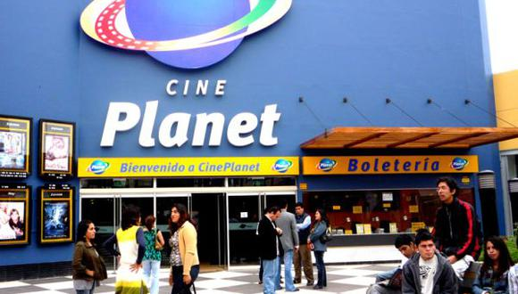
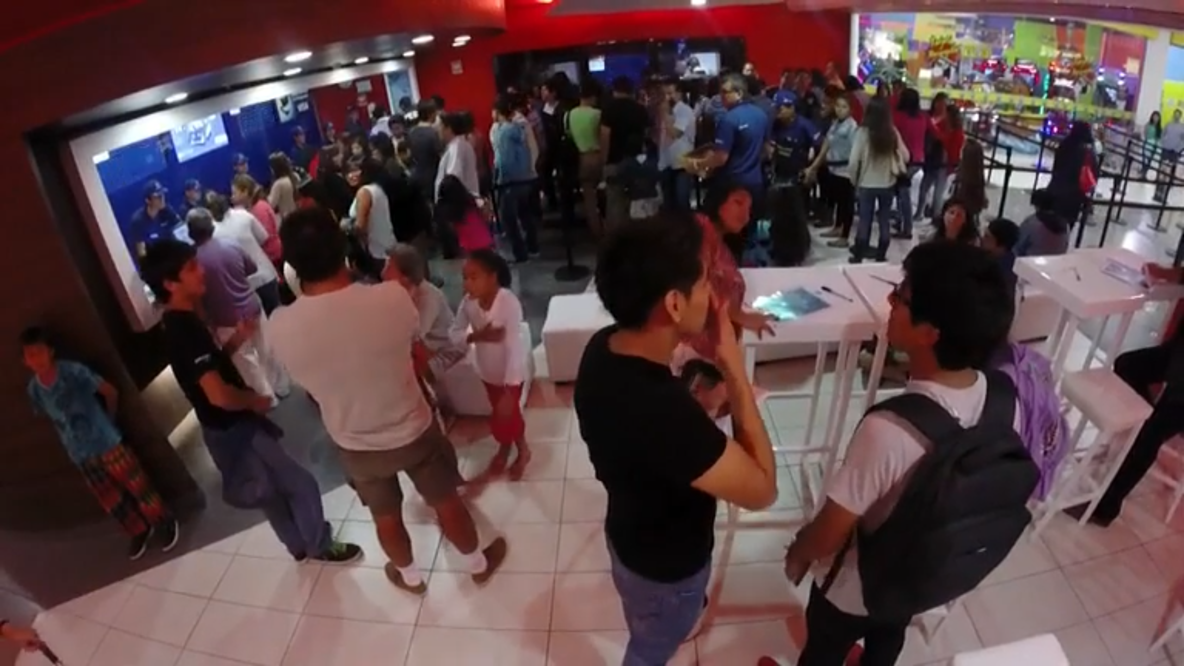
IDEO Background
Design/consulting firm, HQ in San Francisco
Design thinking to design products/services/experiences
Products: Apple’s first mouse, Palm V PDA, Steelcase Leap
Focal client: Peru’s Cineplanet

Slide 4
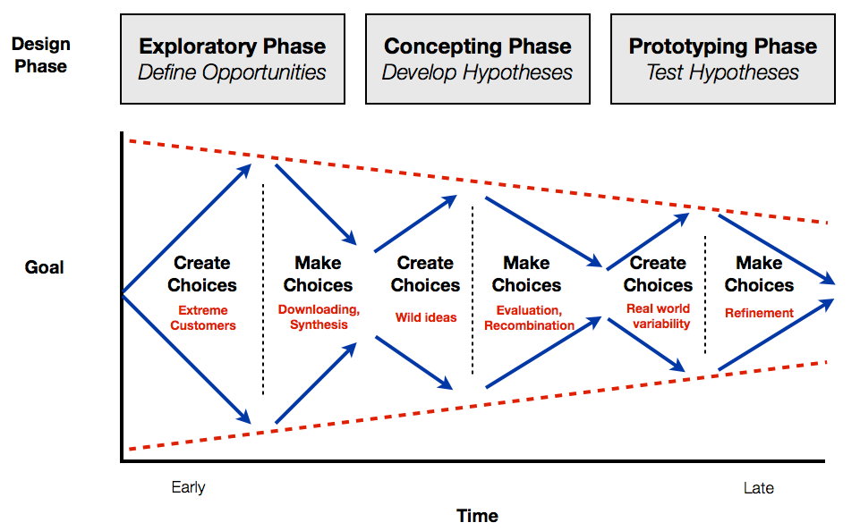
IDEO Design Thinking
Empathy
Define
Ideate
Prototype
Test

Slide 5



IDEO Exploratory
Inductive: learn from the bottom up, can help overcome the problem of the unknown unknowns.
Project team spent 4 weeks on the ground in Peru observing and interacting with customers and other stakeholders
In-depth interviews with current/ potential end users
Deductive: learn from the top down, as through surveys to collect lots of answers to simple, well-defined questions
Deductive
Low knowledge
High knowledge
Inductive

Slide 6
IDEO Exploratory
Empathy
Define
Learn about the audience for whom you are designing
Ex. at home, tools (phones, TV, couch), calendar exercise, showing concepts, “how do you imagine”, building trust
Interview extreme users
Divergent thinking
Refine + focus your question based on your insights
Ex. “downloading”
Discuss shared experience helps relive and process, highlights the most salient takeaways
Convergent thinking

Slide 7
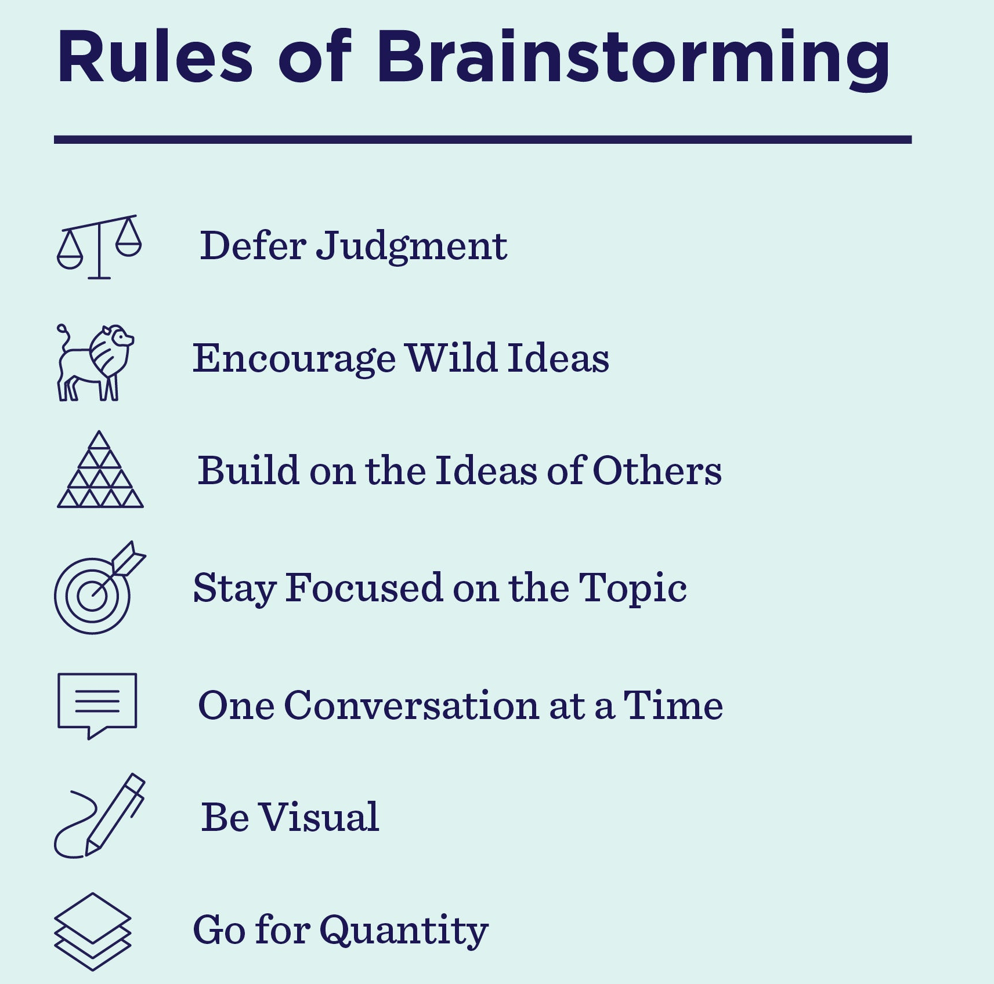
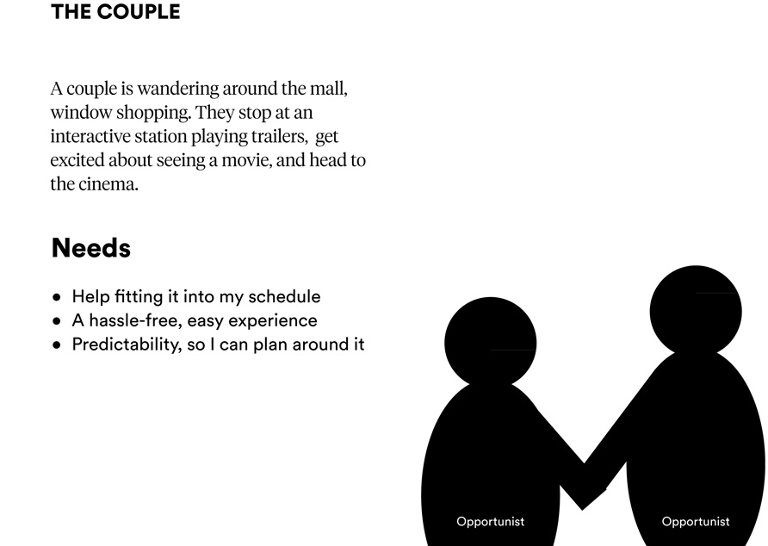
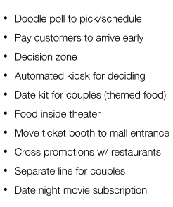
IDEO Concepting

Slide 8
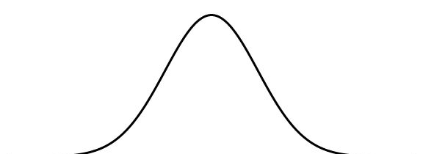
IDEO Concepting
Ideate
Brainstorm + come up with creative solutions
Divergent: Wide + wild range of ideas
Convergent: Iterate, evaluate ideas
Lower mean?
Vote with your trash!
Iterate!
Recombine!
Proportion of Ideas
More really great ideas!
Low
Idea Quality
High

Slide 9
IDEO Prototyping
Prototype
Test
Build a representation of your idea to show others
Ex. build a virtual/physical product, roleplay service interaction, mock-up a physical environment
Make ideas tangible, out of the designer’s head, so others can understand, interact with it
Return to your original user group for testing and feedback
Users can interact with prototype and provide feedback that can be used to incrementally improve the concept / surface other approaches which may potentially be more effective
Divergent: Real world variability
Convergent: Evaluate, refine ideas

Slide 10
IDEO Prototyping
When is a prototype developed enough that we can share it with the world?
Underdeveloped
Customers may not understand/ be able to engage meaningfully
Poor representation of attributes we’re trying to test/real conditions
Not taken seriously by users and employees, or may be distracting
Prototypes lack coherence with other design elements
Execution problems get in the way of the test
Overdeveloped
Too expensive
Take too long to create
Lack flexibility to allow for iteration: improving the design based on emerging insights
Elicit a yes/no reaction from users, rather than a conversation about how an idea might be made better

Slide 11
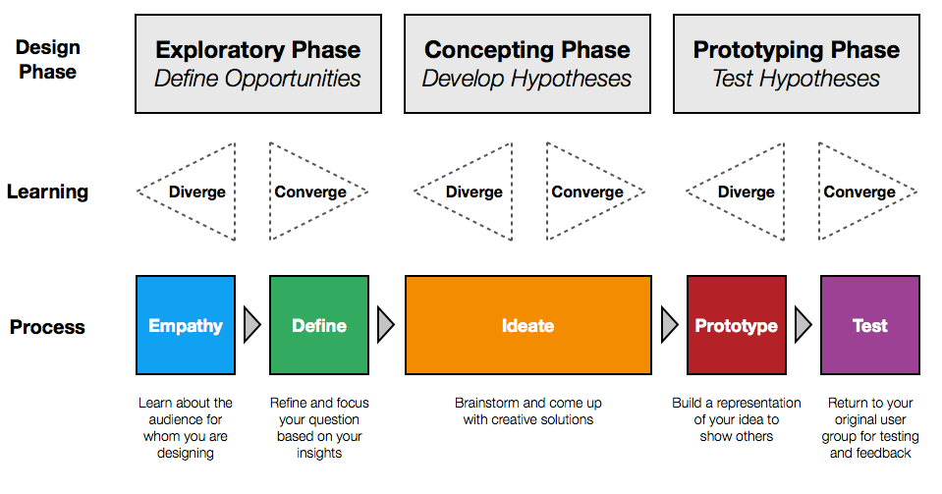
IDEO Takeaways
Design Thinking = Human-centered service design process
Turning creativity and innovation into org. capabilities, increasing buy-ins and avoiding losing sight of what matters
Process transparency = revealing the BTS work inherent in the design process = perceived value throughout the org. + customers; more invested in org. transformation
Customer transparency through empathy and human-centeredness, increasing perceived appreciation/impact, in turn, increasing job satisfaction and effort

Slide 12
Littlefield Takeaways
Reaction time matters:
Machine purchases based on long-run behavior
Contract management based on short-run behavior
Factory physics matter:
A busy factory (high utilization) is “efficient” but drives up leadtimes – must balance factory productivity with customer needs
Variability in operations is painful
Managing raw materials requires balancing holding costs and fixed order placement costs – EOQ thinking
End game is a gamble between too much and too little – a possible application of newsvendor thinking
Cash is king – manage it carefully to avoid death spirals!

Slide 13
What’s Next
Pick up practice final + solution on your way out!
Tonight: Park’s OH 9-10pm on Zoom
Tomorrow: HW5 due 11:59pm, Hansheng’s OH 1-2pm @ N455
Wednesday: Wrap-up + Evaluation + Final Flash Review
Friday: Final Review at Discussion + Hansheng’s OH 2-3pm @ N455
Additional office hours next week to be announced (all on Zoom)
May 11: Final Exam 3-6pm @ N270 + Project Report due at 11:59pm

